Slide 1
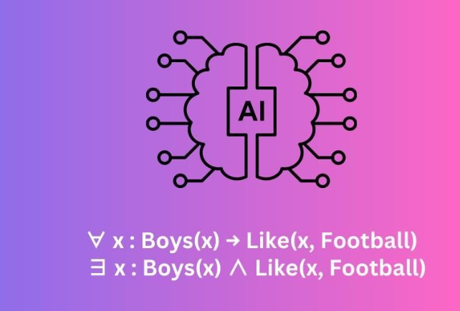
Predicate Logic

Slide 2
Course Outcome:
Use suitable knowledge representation techniques for AI-based applications.
Session Outcomes:
Understand Predicate Logic and its components.
Represent facts and relationships using predicates and quantifiers.
Apply Predicate Logic for knowledge representation in AI applications.

Slide 3
Basic Concepts for First Order Logic in Artificial Intelligence
Propositions:
Propositions are statements or assertions that are either true or false.
In the context of logic, propositions are typically represented by letters or symbols and serve as the fundamental units of logic.
Examples of propositions: "The sky is blue," "2 + 2 = 4," "It is raining.“
Predicates:
Predicates are expressions that contain variables and represent properties, relationships, or characteristics that can be true or false for different objects or individuals.
It is an additional information to better express the subject of the sentence.
Predicates are usually represented by uppercase letters or words. They are used to form atomic formulas when applied to specific objects.
Examples of predicates:
  "IsRed(x)" checks if x is red
  "IsParent(x, y)" checks if x is the parent
  "IsPrime(x)“checks if a number x is prime.

Slide 4
Difference Between Propositions and Predicates
Propositions are simple statements with a definite truth value (true or false) and do not contain variables.
Predicates, on the other hand, are more complex and contain variables that can be substituted with constants or variables to create specific statements about objects.
They represent properties or relations that can be true or false for different instances.

Slide 5
First-Order logic
First-order logic is another way of knowledge representation in artificial intelligence.
It is an extension to propositional logic.
FOL is sufficiently expressive to represent the natural language statements in a concise way.
First-order logic is also known as Predicate logic or First-order predicate logic.
First-order logic is a powerful language that develops information about the objects in a more easy way and can also express the relationship between those objects.
First-order logic (like natural language) does not only assume that the world contains facts like propositional logic but also assumes the following things in the world:
  Objects: A, B, people, numbers, colors, wars, theories, squares, pits, wumpus, etc.
  Relations: It can be unary relation such as: red, round, is adjacent, or n-any relation such as: the sister of, brother of, has color, comes between, etc.
  Function: Father of, best friend, third inning of, end of, etc.
As a natural language, first-order logic also has two main parts:
  Syntax
  Semantics

Slide 6
Syntax of First-Order logic
The syntax of first-order logic consists of symbols and rules for constructing well-formed formulas (WFFs), which are statements or formulas in the language of FOL.
Semantics in first-order logic deals with the interpretation of sentences and formulas within the framework of a mathematical model.
It provides a way to assign meanings to the symbols and structures used in first-order logic.
Syntax → How to write
Semantics → What it means

Slide 7
Components of Predicates in AI
Predicates – Relations or properties (e.g., Parent(x, y), Even(x)).
Arguments – Constants, variables, or functions (e.g., x, y, John).
Quantifiers – To express generality:
  Universal (∀) → "For all"
    ∀x Human(x) → All x are humans.
  Existential (∃) → "There exists"
    ∃x Likes(x, icecream) →There exist Someone likes icecream.

Slide 8
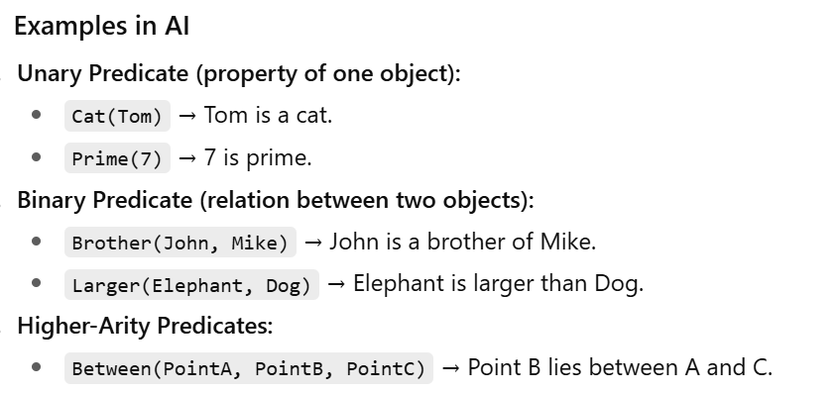
Example Predicates
“ Not all integers are even “ is equivalent to “ Some integers are not even “
“Some birds don’t fly.” is equivalent to “Not all birds fly “

Slide 9
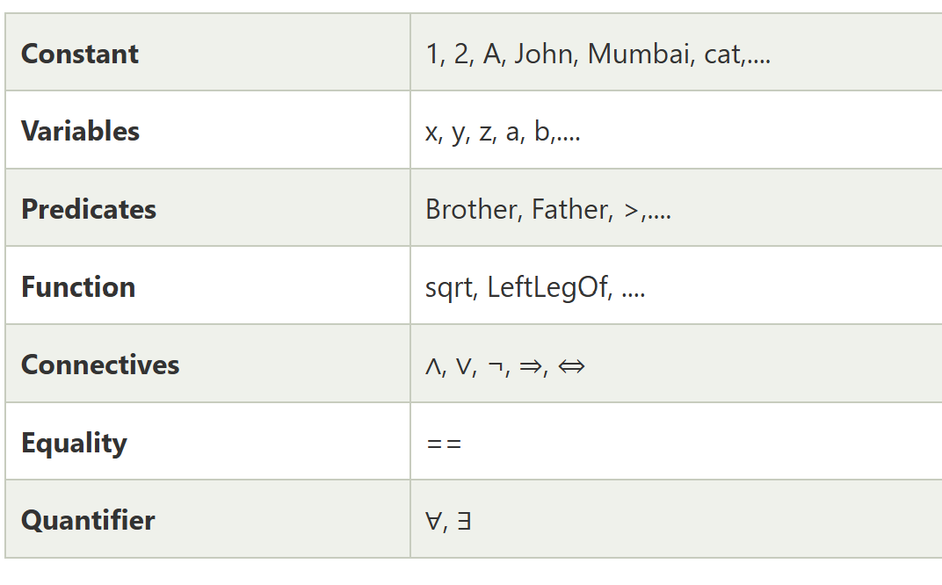
Basic Elements of First-order logic

Slide 10
Atomic sentences
Atomic sentences are the most basic sentences of first-order logic.
These sentences are formed from a predicate symbol followed by a parenthesis with a sequence of terms.
We can represent atomic sentences as
Predicate (term1, term2, ......, term n).
Example:
  Ravi and Ajay are brothers: => Brothers(Ravi, Ajay)
  Milky is a cat: => cat (Milky)

Slide 11
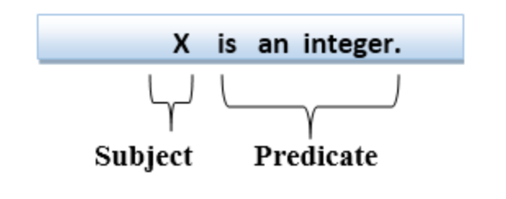
Complex Sentences
Complex sentences are made by combining atomic sentences using connectives.
First-order logic statements can be divided into two parts:
Subject: Subject is the main part of the statement.
Predicate: A predicate can be defined as a relation, which binds two atoms together in a statement.
Consider the statement: "x is an integer.", it consists of two parts, the first part x is the subject of the statement and second part "is an integer," is known as a predicate.

Slide 12
Quantifiers in First-order logic
A quantifier is a language element which generates quantification, and quantification specifies the quantity of specimen in the universe of discourse.
These are the symbols that permit to determine or identify the range and scope of the variable in the logical expression.
There are two types of quantifier:
  Universal Quantifier, (for all, everyone, everything)
  Existential quantifier, (for some, at least one).

Slide 13
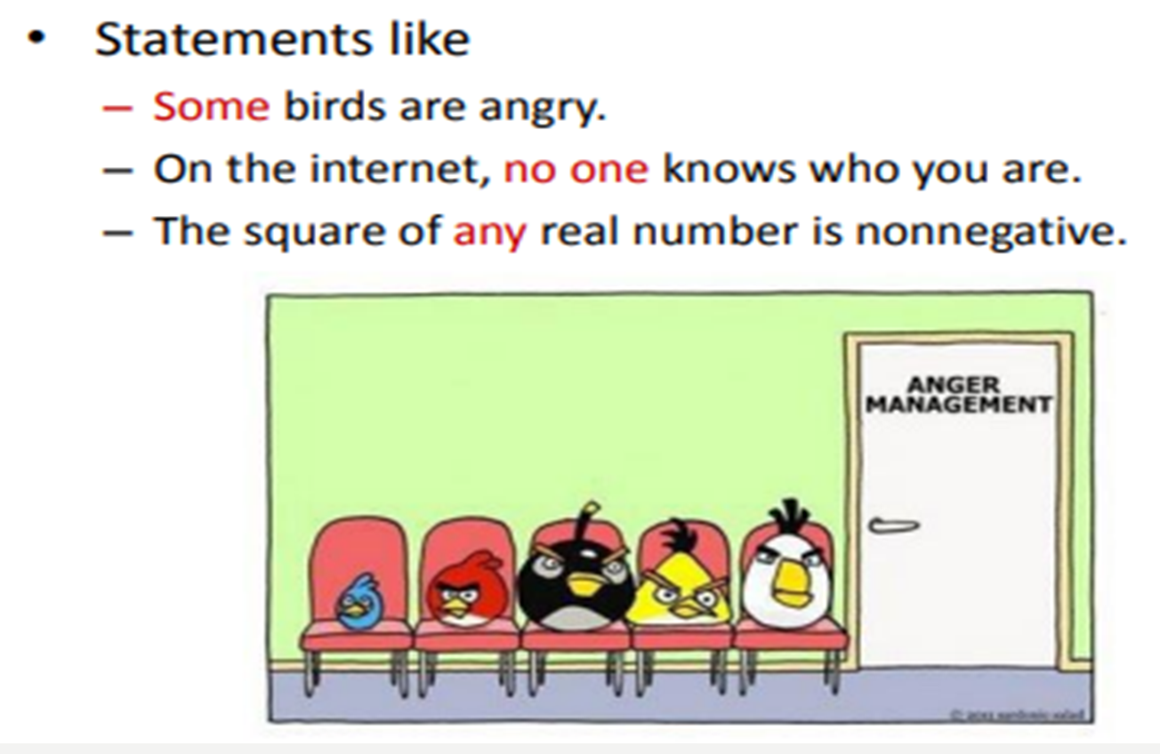

Slide 14
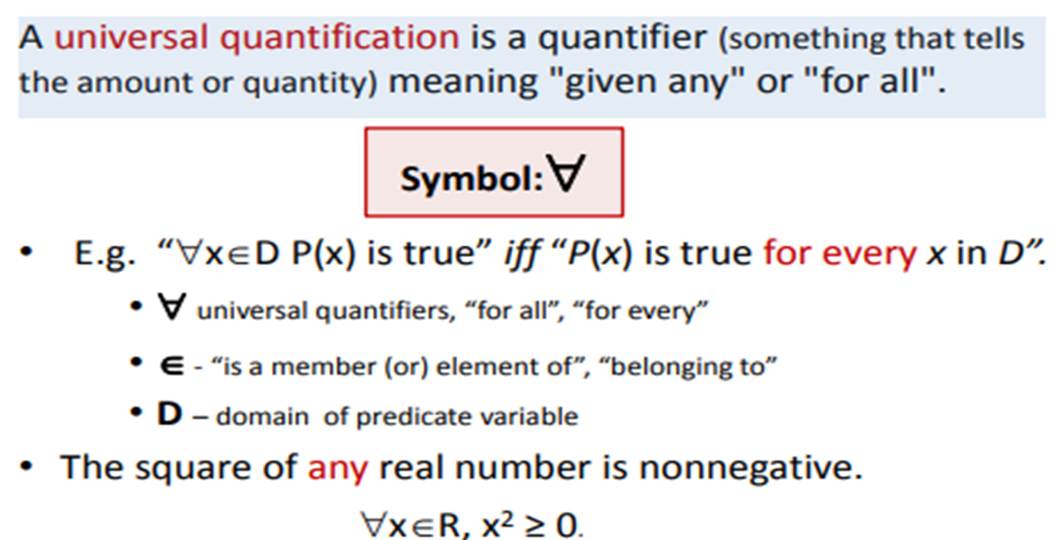

Universal Quantification

Slide 15
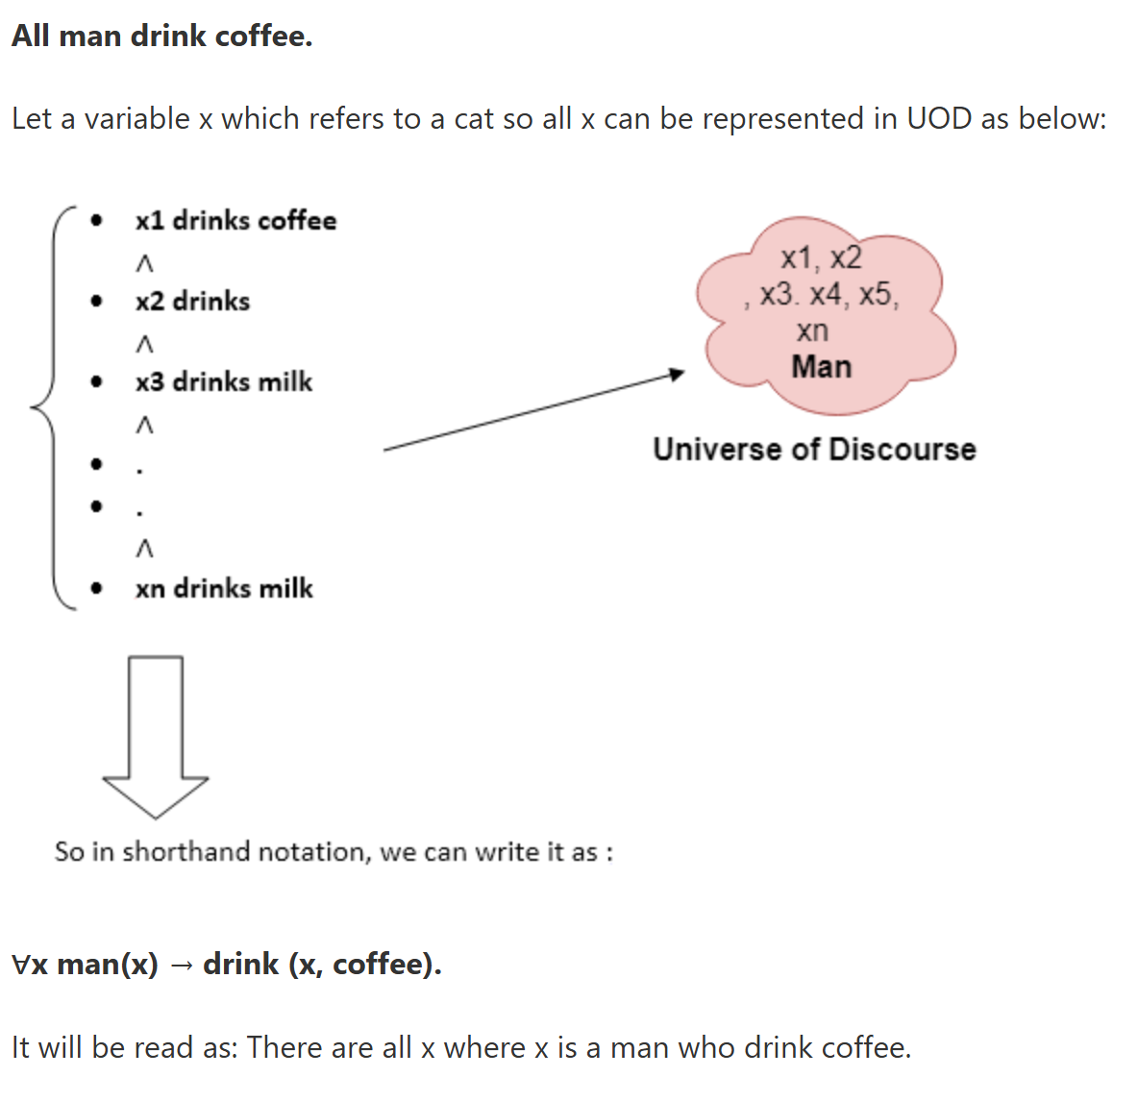
Example

Slide 16
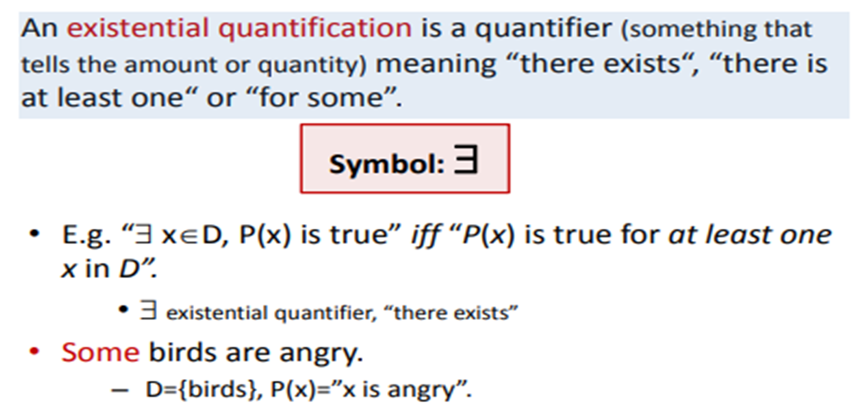


Existential Quantification

Slide 17
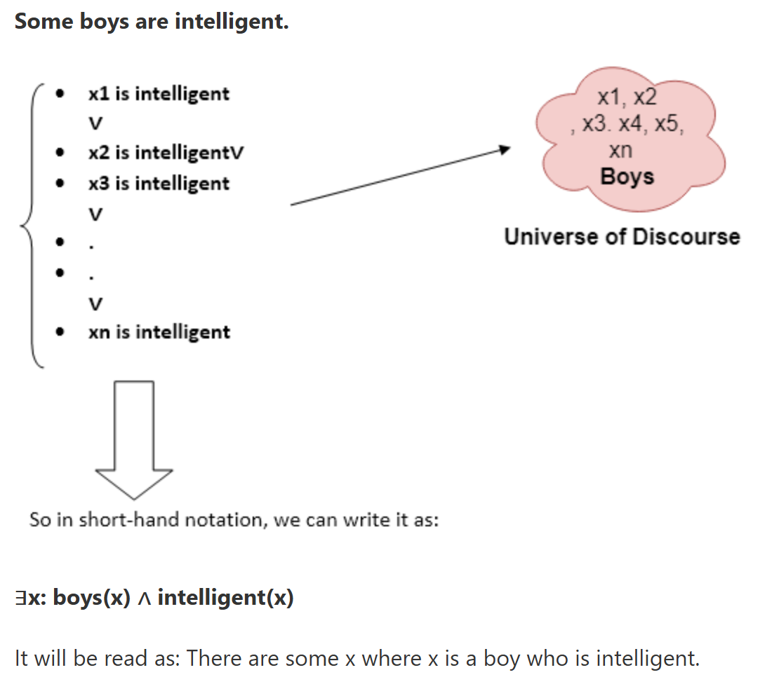
Example

Slide 18
Every orange cat is fluffy
Everybody loves at least one friend
Any pancake x tastes similar to any pancake y
Any two pancakes x and y taste similar
Every student walks or talks

Slide 19
Fluffy(x)` will represent "x is fluffy."
`OrangeCat(x)` will represent "x is an orange cat."
∀x (Orange(Cat(x)) → Fluffy(x))
`Loves(x, y)` will represent "x loves y."
∀x ∃y love (x, y)
TastesSimilar(x, y)
∀x (Pancake(x) → ∀y (Pancake(y) → TasteSimilar(x, y) ) )
∀x ∀y (Pancake(x) ∧ Pancake(y) → TasteSimilar(x, y) )
∀x (student(x) → (walk (x) ∨ talk (x)))

Slide 20
Properties of Quantifiers
1. All birds fly.
In this question the predicate is "fly(bird)."
And since there are all birds who fly so it will be represented as follows.
∀x bird(x) →fly(x).
2. Every man respects his parent.
In this question, the predicate is "respect(x, y)," where x=man, and y= parent.
Since there is every man so will use ∀, and it will be represented as follows:
∀x man(x) → respects (x, parent).
3. Some boys play cricket.
In this question, the predicate is "play(x, y)," where x= boys, and y= game. Since there are some boys so we will use ∃, and it will be represented as:
∃x boys(x) → play(x, cricket).
4. Not all students like both Mathematics and Science.
In this question, the predicate is "like(x, y)," where x= student, and y= subject.
Since there are not all students, so we will use ∀ with negation, so following representation for this:
¬∀ (x) [ student(x) → like(x, Mathematics) ∧ like(x, Science)].
5. Only one student failed in Mathematics.
In this question, the predicate is "failed(x, y)," where x= student, and y= subject.
Since there is only one student who failed in Mathematics, so we will use following representation for this:
∃(x) [ student(x) → failed (x, Mathematics) ∧∀ (y) [¬(x==y) ∧ student(y) → ¬failed (x, Mathematics)].

Slide 21
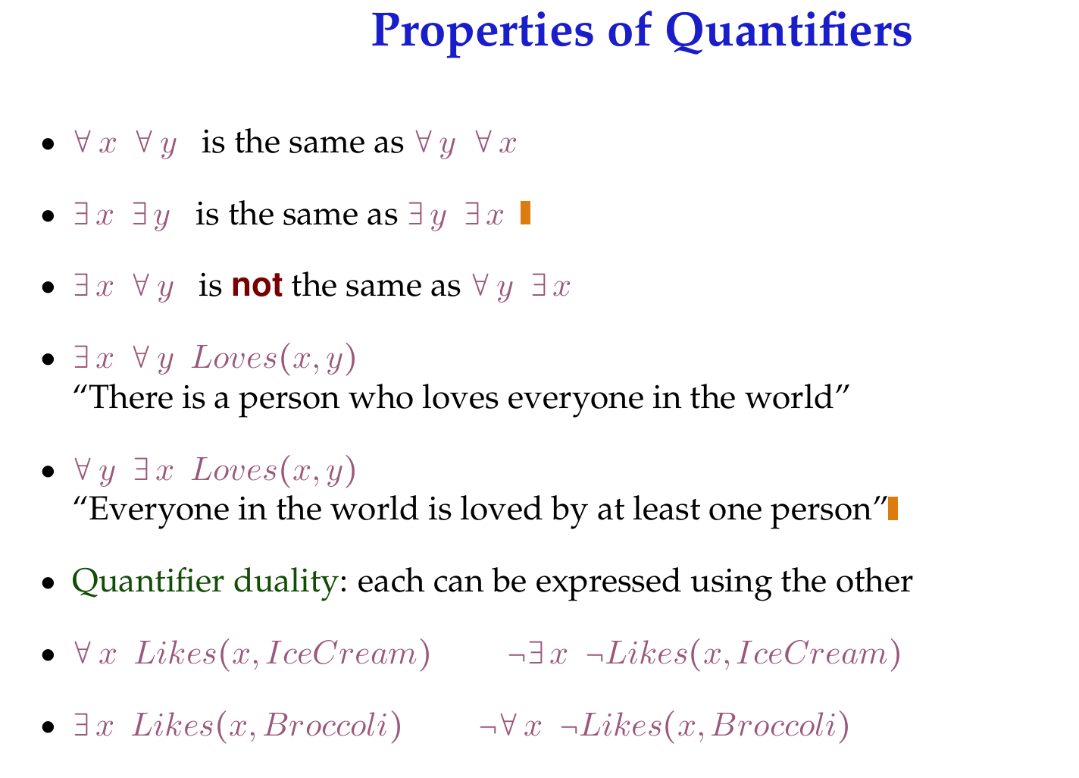

Slide 22
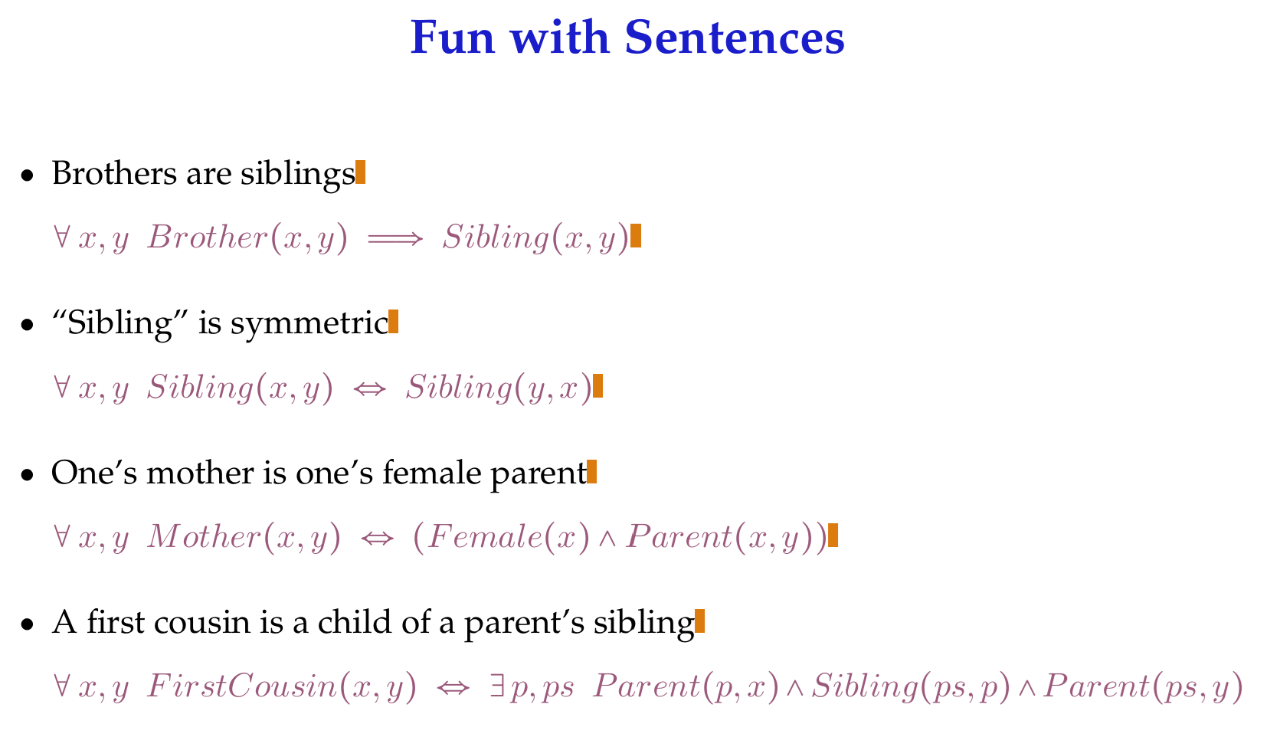

Slide 23
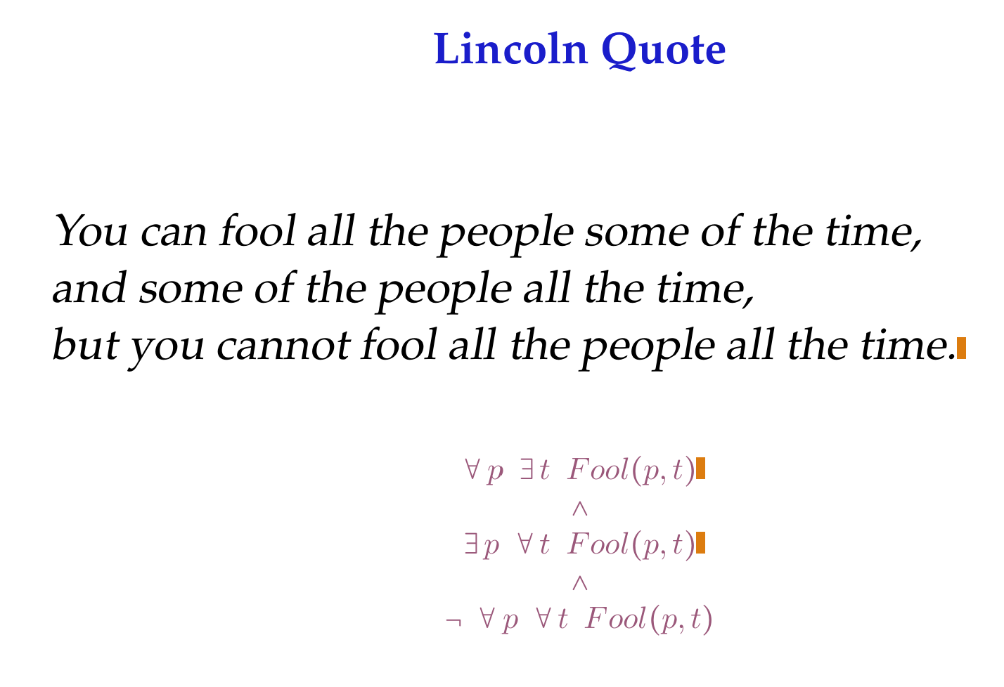

Slide 24
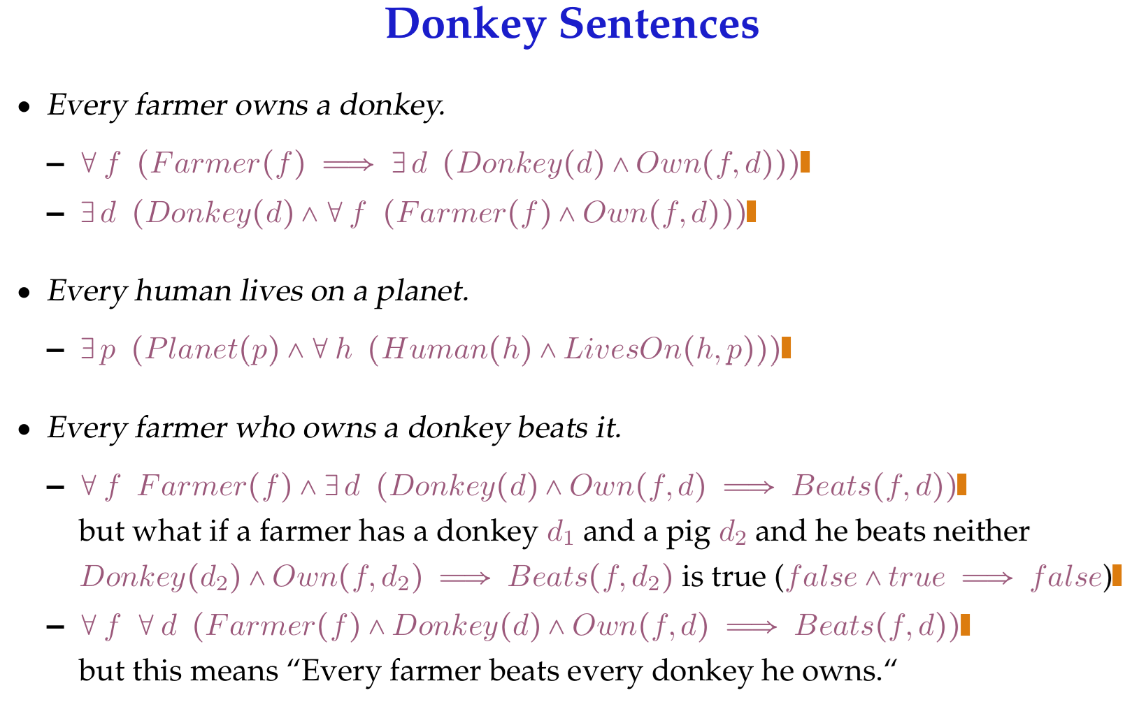

Slide 25
Example
Marcus was a man.
Marcus was a Pompeian.
All Pompeians were Romans.
Caesar was a ruler.
Also, All Pompeians were either loyal to Caesar or hated him.
Everyone is loyal to someone.
People only try to assassinate rulers they are not loyal to.
Marcus tried to assassinate Caesar.

Slide 26
Predicate logic
Marcus was a man.
  man(Marcus)
Marcus was a Pompeian.
  Pompeian(Marcus)
All Pompeians were Romans.
  ∀x: Pompeian(x) → Roman(x)
Caesar was a ruler.
  ruler(Caesar)

Slide 27
More examples
All Pompeians were either loyal to Caesar or hated him.
  inclusive-or
  ∀x: Roman(x) → loyalto(x, Caesar) ∨ hate(x, Caesar)
  exclusive-or
  ∀x: Roman(x) → (loyalto(x, Caesar) ∧¬ hate(x, Caesar)) ∨
  (¬loyalto(x, Caesar) ∧ hate(x, Caesar))
Everyone is loyal to someone.
  ∀x: ∃y: loyalto(x, y)
People only try to assassinate rulers they are not loyal to.
  ∀x: ∀y: person(x) ∧ ruler(y) ∧ tryassassinate(x, y)
  →¬loyalto(x, y)
Marcus tried to assassinate Caesar.
  tryassassinate(Marcus, Caesar)

Slide 28
Representation & Mapping
Spot is a dog.
  dog(Spot)
Every dog has a tail.
  ∀x (dog(x) → hastail(x))
Spot has a tail.
  hastail(Spot)
All humans are mortal. Socrates is a human.
  ∀x (Human(x) → Mortal (x))
  Human(Socrates)
  Mortal(Socrates)
All cats are animals.
  ∀x (Cat(x) → Animal(x))
Cats eat fish.
  ∀x (Cat(x) → Eats(x, Fish))
All parents love their children.
  ∀x∀y (Parent(x,y) → Loves(x,y))
Every student is enrolled in the course Artificial Intelligence.
  ∀x(Student(x)→Enrolled(x, Artificial Intelligence))
Every author of a book is a person.
  ∀x (Author(x, Book) → Person(x))

Slide 29
Example
Marcus was a man.
man(Marcus)
Marcus was a Pompeian.
Pompeian(Marcus)
Marcus was born in 40 A.D.
born(Marcus, 40)
All men are mortal.
x: man(x) → mortal(x)
All Pompeians died when the volcano erupted in 79 A.D.
erupted(volcano, 79) ∧ ∀ x : [Pompeian(x) → died(x, 79)]
No mortal lives longer than 150 years.
x: t1: At2: mortal(x) born(x, t1) gt(t2 – t1,150) → died(x, t2)
It is now 1991.
now = 1991
Alive means not dead
∀ x ∀ t : alive(x,t) → ~dead(x,t) ∧ ~dead(x,t) → alive(x,t)
If someone dies, then he is dead at all later times.
∀ x ∀ t1 ∀ t2: died(x,t1) ∧ gt(t2,t1) → dead(x,t2)

